Slide 1
DBMS MINI PROJECT
ON
FIFA 23 PLAYER MANAGEMENT SYSTEM
By:- Parmekar Shubham Rajendra ( 1KT20CS052)
Inao Lakhong Singpho(1KT21CS401)

Slide 2
INTRODUCTION
The project titled “FIFA 23 Player management system” is player management software for monitoring and accessing players based on their FIFA 23 PC/XBOX Game ratings.
This project is developed using HTML, CSS and JavaScript for front-end and PHP, MySQL for back-end, which focuses on basic operation like adding a new player, new statistics, searching players with detailed information and edit as they grow their skills.

Slide 3
SOFTWARE USED
WAMP
MICROSOFT EDGE
BRACKETS WEB EDITOR

Slide 4
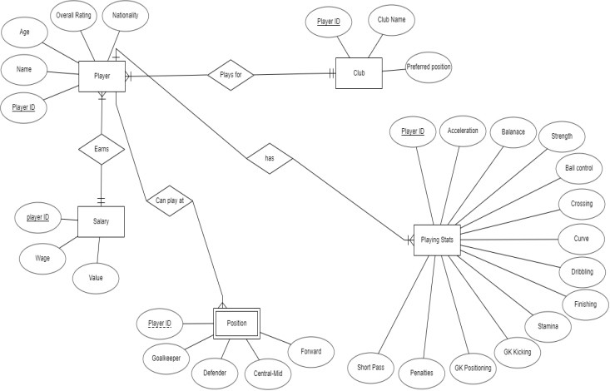
ER DIAGRAM

Slide 5
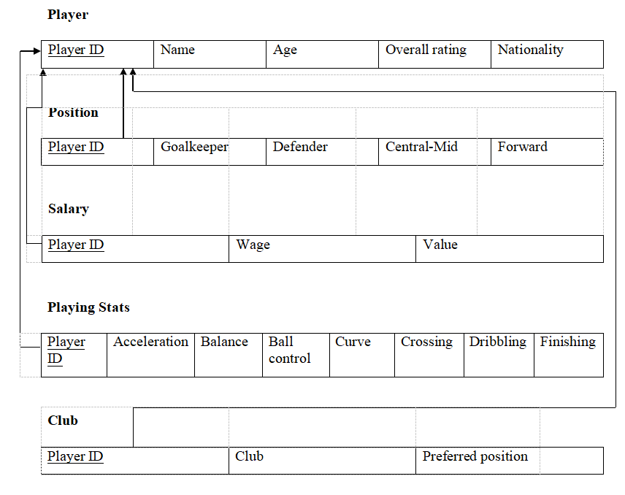
SCHEMA DIAGRAM

Slide 6
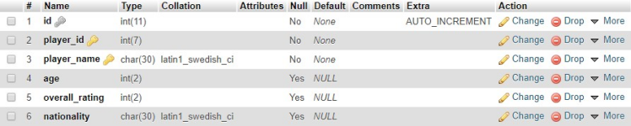
TABLES
PLAYER TABLE STRUCTURE

Slide 7
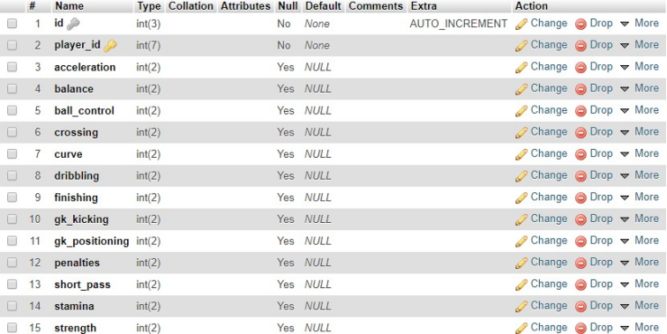
PLAYER STATS TABLE STRUCTURE

Slide 8
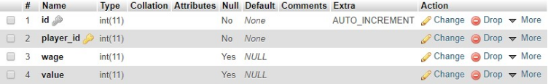
SALARY TABLE STRUCTURE

Slide 9
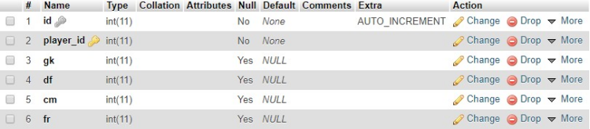
POSITION TABLE STRUCTURE

Slide 10
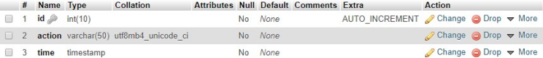
UPDATE, INSERT AND DELETE TABLE STRUCTURES

Slide 11
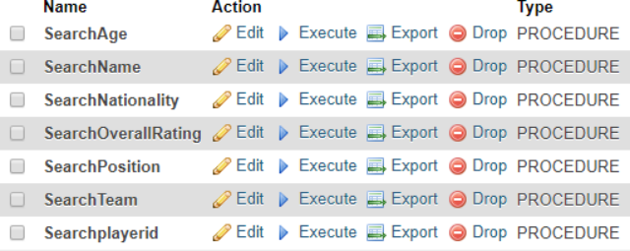
STORED PROCEDURES STRUCTURES

Slide 12
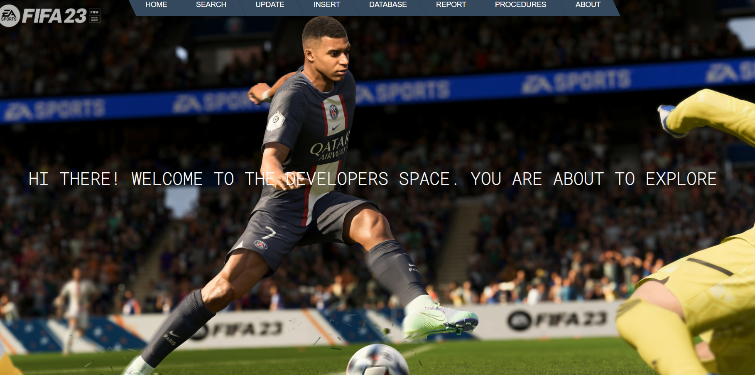
SCREENSHOTS
HOME SCREEN

Slide 13
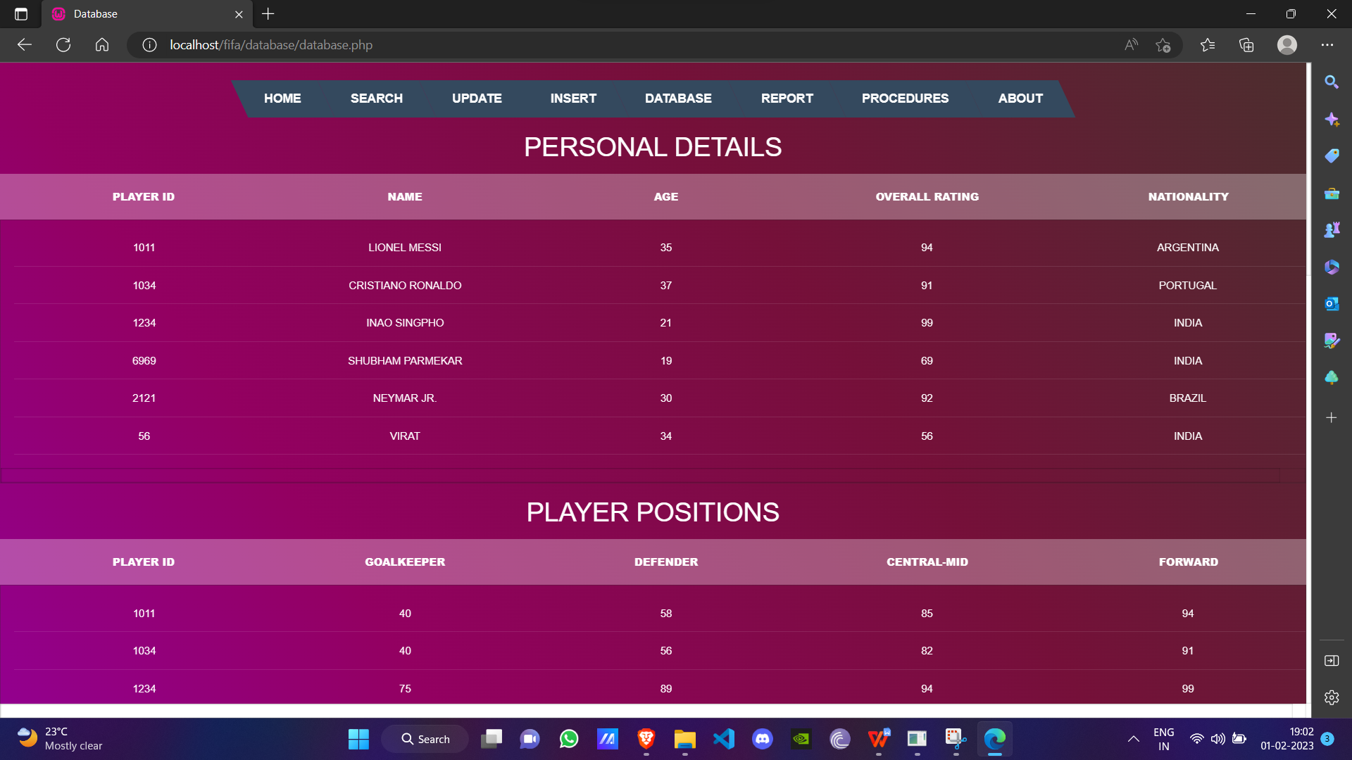

Slide 14
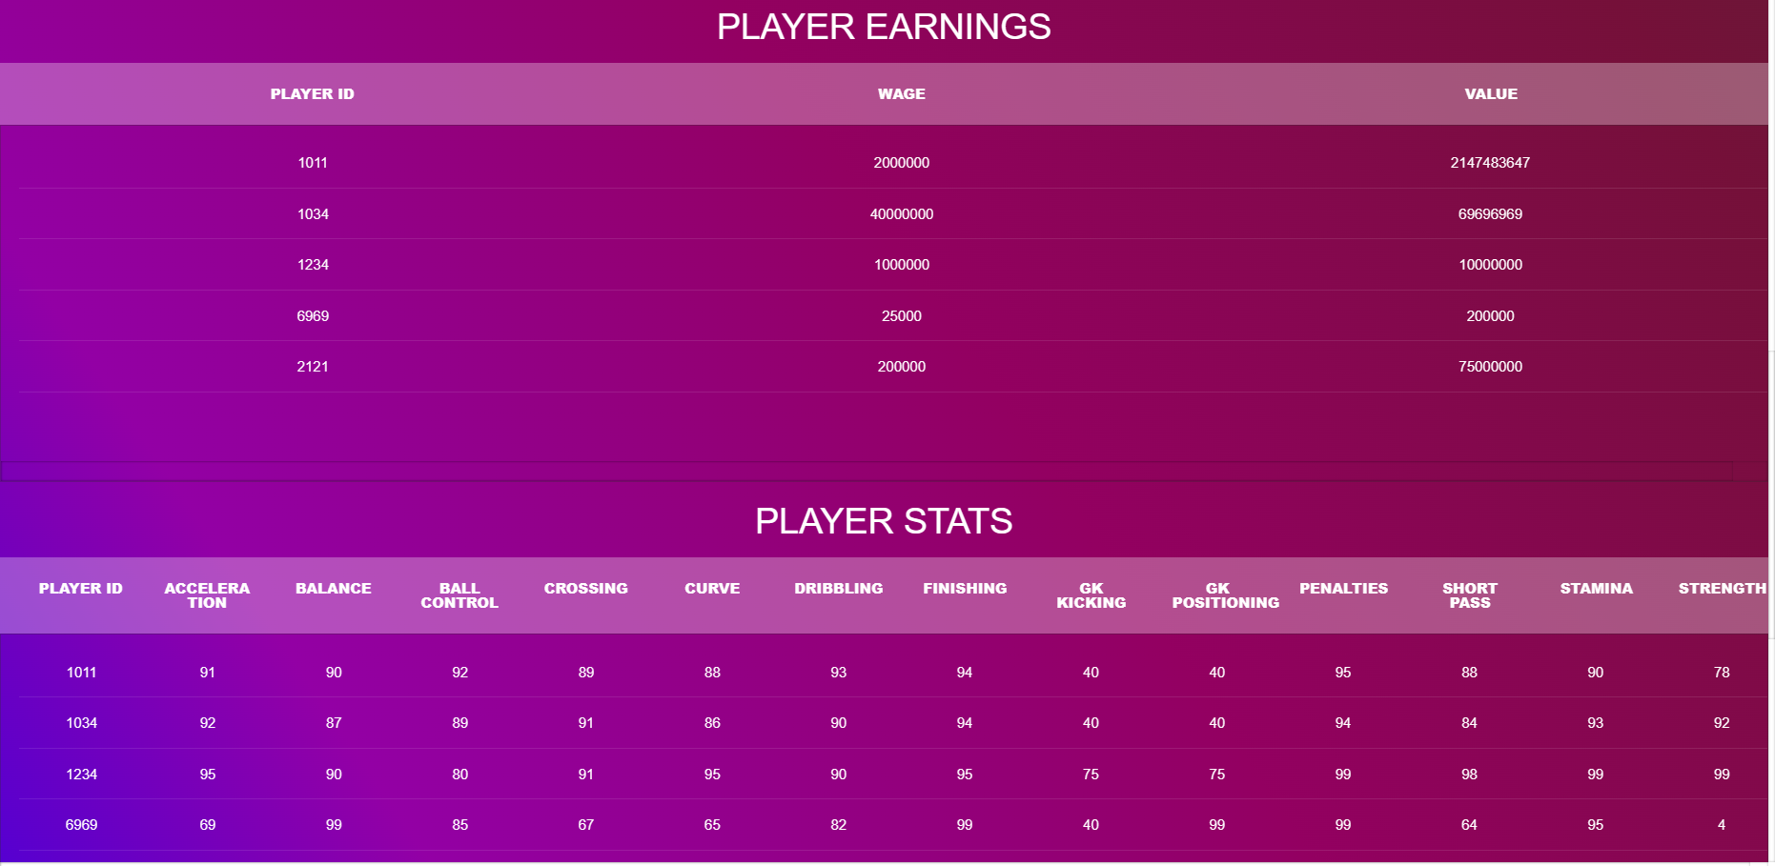

Slide 15
